Slide 1
WILDEX
Animal Classifier

Slide 2
Introduction
WILDEX is an image web application for classification of different 100 Animal species by Convolution Neural Network using Fastai Library.
We used Transfer learning in order to achieve maximum accouracy as possible. Resnet50 is used learn features of image and algorithm is optimized using Back Propagation(BP), Neural Networks and SVMs for classification of different 100 animals species.
I’m enthralled by the power and capability of neural networks. Almost every breakthrough happening in the machine learning space right now has neural network models at its core.

Slide 3
Machine learning
Machine learning is an application of artificial intelligence (AI) that provides systems the ability to automatically learn and improve from experience without being explicitly programmed. Machine learning focuses on the development of computer programs that can access data and use it learn for themselves.
The types of machine learning algorithms differ in their approach, the type of data they input and output, and the type of task or problem that they are intended to solve.
Some of the common types of machine
learning algorithms are:
Supervised Learning
Unsupervised Learning
Reinforcement learning

Slide 4
Deep learning
Deep learning (also known as deep structured learning or hierarchical learning) is part of a broader family of machine learning methods based on artificial neural networks. Learning can be supervised, semi-supervised or unsupervised
Deep learning architectures such as deep neural networks, deep belief networks, recurrent neural networks and convolutional neural networks have been applied to fields including computer vision, speech recognition, natural language processing, audio recognition, social network filtering, machine translation, bioinformatics, medical image analysis, material inspection and board game programs, where they have produced results comparable to and in some cases superior to human experts.

Slide 5
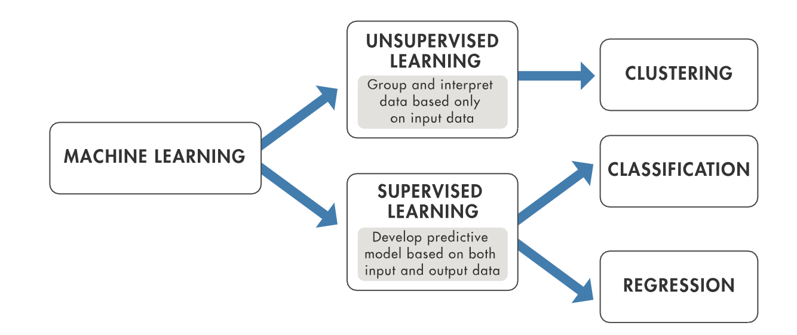
Machine learning algorithms
Machine Learning algorithms are methods which are problem specific. These algorithms can be used to solve some of the real-life common problems.
Some of the common machines learning algorithms are:
K-Nearest Neighbours
K-Means
Linear Regression
Logistic Regression
Decision Trees
Random Forest

Slide 6
What is image classifier
Image classification refers to a process in computer vision that can classify an image according to its visual content. For example, an image classification algorithm may be designed to tell if an image contains a human figure or not. While detecting an object is trivial for humans
It uses the feature of images in order to
classify them into different no. of categories as
we have done in our project

Slide 7
uses of image classification
Automated Image Organization – from Cloud Apps to Telecoms
Visual Search for Improved Product Discoverability using AR technology
Image and Face Recognition on Social Networks or phone unlocking
Creating city guides
Boosting augmented reality applications and gaming
Teaching machines to see

Slide 8
Working of image classification
Image data
CNN
(Resnet50)
Training on neural net
Result

Slide 9
ToOLS/algorithm used
Keras
CNN (Restnet50)
Flask
Frontend designing
HTML
CSS
Javascript

Slide 10
KERAS
In order to make the most of our few training examples, we will "augment" them via a number of random transformations, so that our model would never see twice the exact same picture. This helps prevent overfitting and helps the model generalize better.
Keras features:
fit_generator for training Keras a model using Python data generators
ImageDataGenerator for real-time data augmentation
layer freezing and model fine-tuning
...and more

Slide 11
Cnn(resnet50)
A residual neural network is an artificial neural network of a kind that builds on constructs known from pyramidal cells in the cerebral cortex. Residual neural networks do this by utilizing skip connections, or short-cuts to jump over some layers
The network learns several low/mid/high level features at the end of its layers. In residual learning, instead of trying to learn some features, we try to learn some residual. Residual can be simply understood as subtraction of feature learned from input of that layer. ResNet does this using shortcut connections (directly connecting input of nth layer to some (n+x)th layer. It has proved that training this form of networks is easier than training simple deep convolutional neural networks and also the problem of degrading accuracy is resolved.

Slide 12
flask
Flask is a web application framework written in Python. Armin Ronacher, who leads an international group of Python enthusiasts named Pocco, develops it. Flask is based on Werkzeug WSGI toolkit and Jinja2 template engine. Both are Pocco projects.
Flask supports extensions that can add application features as if they were implemented in Flask itself. Extensions exist for object-relational mappers, form validation, upload handling, various open authentication technologies and several common framework related tools. Extensions are updated far more frequently than the core Flask program.

Slide 13
Front end desinging
HTML - Hypertext Markup Language is the standard markup language for documents designed to be displayed in a web browser. It can be assisted by technologies such as Cascading Style Sheets and scripting languages such as JavaScript.
CSS - Cascading Style Sheets is a style sheet language used for describing the presentation of a document written in a markup language like HTML. CSS is a cornerstone technology of the World Wide Web, alongside HTML and JavaScript
Javascript - JavaScript, often abbreviated as JS, is a high-level, interpreted scripting language that conforms to the ECMAScript specification. JavaScript has curly-bracket syntax, dynamic typing, prototype-based object-orientation, and first-class functions

Slide 14
RESults of image classification

Slide 15
Accuracy measurement

Slide 16
Results

Slide 17
Thankyou

